Slide 1


Presentation on, “Sorting Algorithm Visualizer” Guide : Prof. Sapna B.Patil
VISVESVARAYA TECHNOLOGICAL UNIVERSITY
BELAGAVI-590018
S.J.P.N TRUST'S
HIRASUGAR INSTITUTE OF TECHNOLOGY,NIDASOSHI-591236
Presented by,
Ganesh Baad (2HN22CS402)
Kartik Chinchani (2HN22CS404)
Aniket Manjaj(2HN21CS005)
Ekanath Anehosur (2HN21CS012)
BRANCH: Computer Science & Engineering

Slide 2
Table of Content
Introduction
Proposed System
Description of Application
System Requirements
System Design
Module Diagram
Snapshots
Applications
Conclusion and future steps

Slide 3
Introduction
Let me introduce the Project which is Sorting Algorithm Visualizer is an educational tool designed to help users understand the inner workings of various sorting algorithms. By providing a dynamic and interactive way to see how sorting algorithms operate, this project aims to make complex concepts more accessible and engaging.

Slide 4
Proposed Systems
System Proposed to User:
The system will visually represent four sorting algorithms.
Sorting algorithms included: Bubble Sort, Insertion Sort, Ripple Sort, Selection Sort.
Provide users with an interactive way to observe and understand sorting techniques.
Implemented using OpenGL and GLUT for graphical representation

Slide 5
Description of Application
Key Features:
Display of sorting process with graphical bars.
Interactive menu for selecting sorting algorithms.
Real-time visualization of sorting steps.
Ability to pause and resume the sorting process.
Randomization of the dataset for sorting.
User Controls:
‘s' to start sorting.
'c' to cycle through sorting algorithms.
'r' to randomize the dataset.
‘p' to pause sorting.
'Esc' to exit the application.

Slide 6
SYSTEM REQUIREMENTS
Hardware Requirements:
At least 2GB of RAM.
OpenGL compatible graphics card.
1GHz processor or higher.
Software Requirements:
Operating System: Windows, macOS, or Linux.
Development Environment: GCC compiler, GLUT library.
Additional Libraries: OpenGL Utility Toolkit (GLUT).

Slide 7
System Design
Main Components:
Array initialization and randomization.
Sorting algorithm implementation.
OpenGL rendering and display functions.
User input handling for interactive controls.
Flow of Execution:
Start with a welcome screen.
Move to the main visualization screen upon user input.
Display the sorting process based on user-selected algorithm.

Slide 8
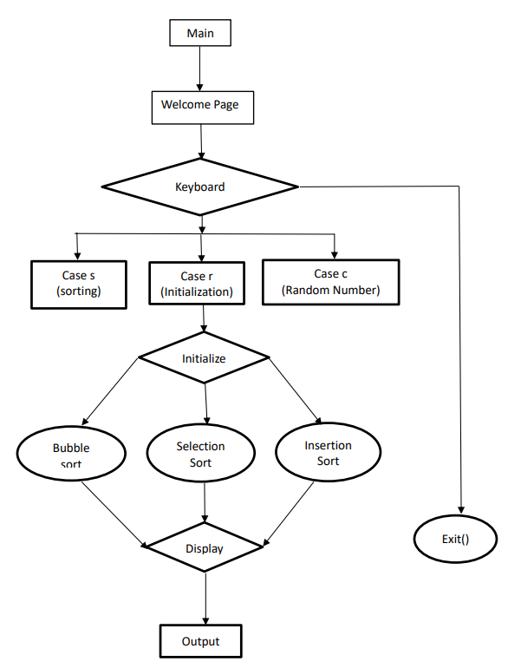
Module Diagram:

Slide 9
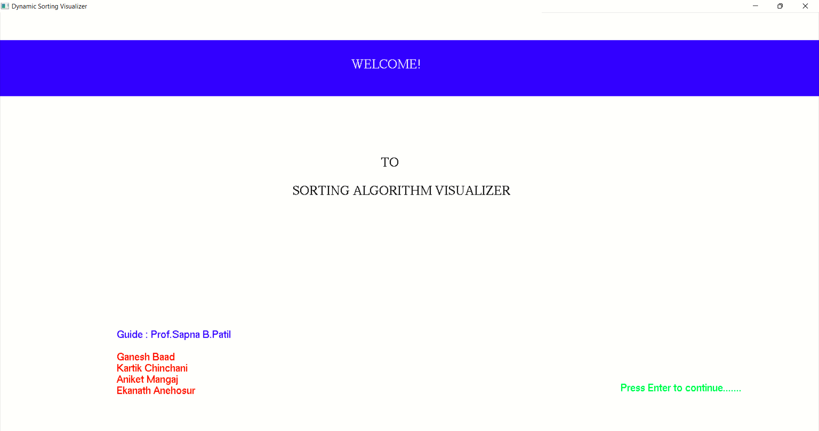
Snapshots:

Slide 10
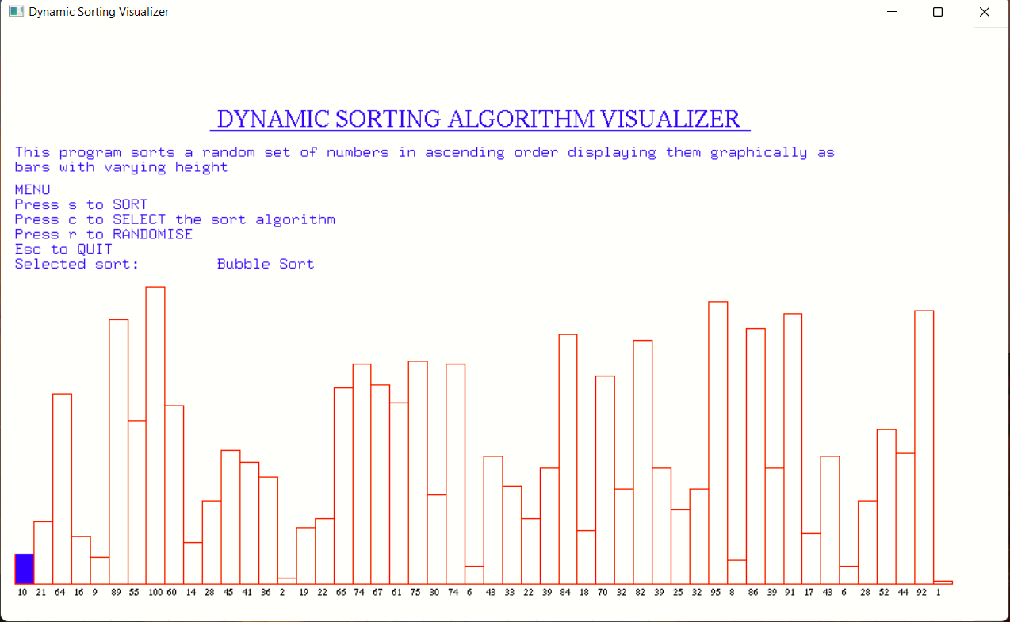
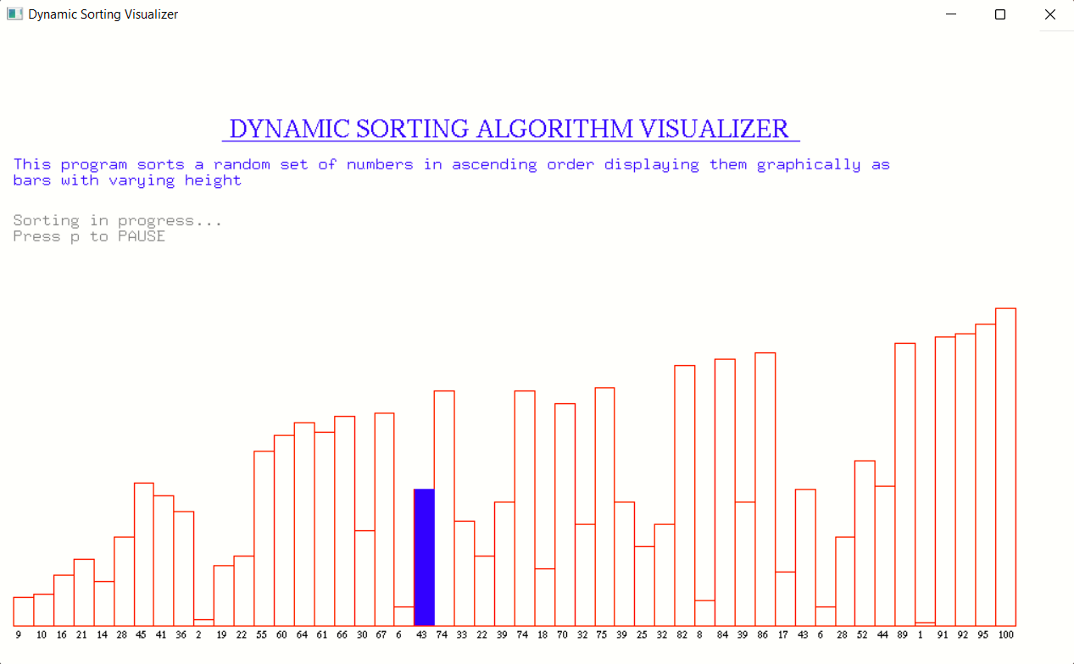

Slide 11
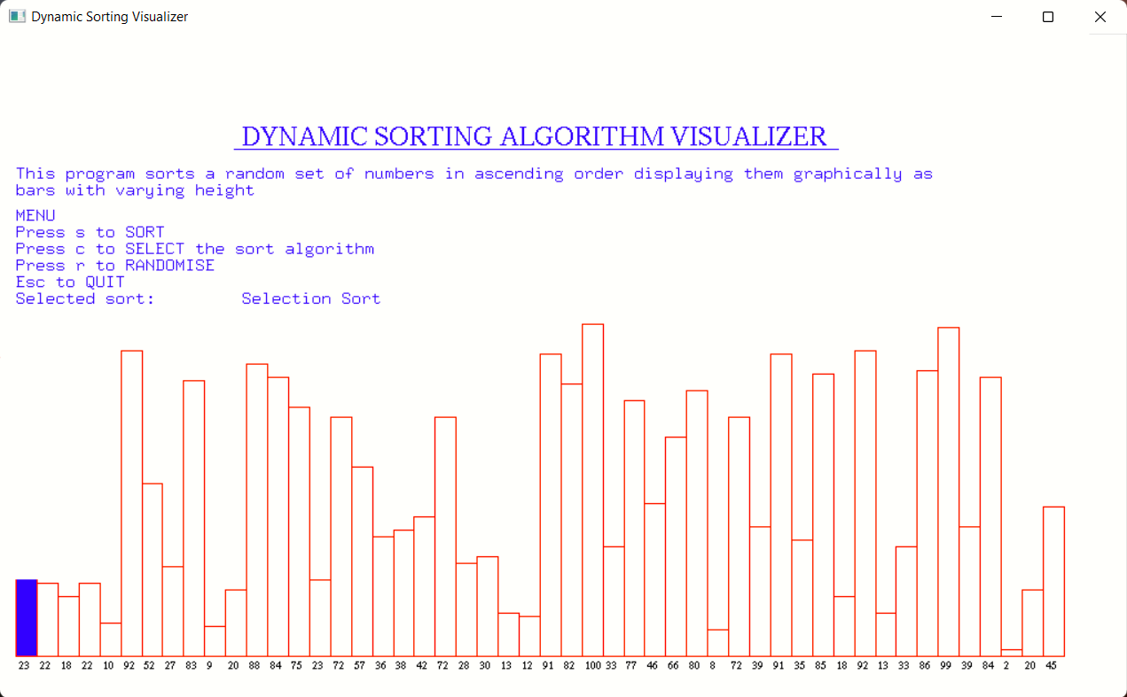
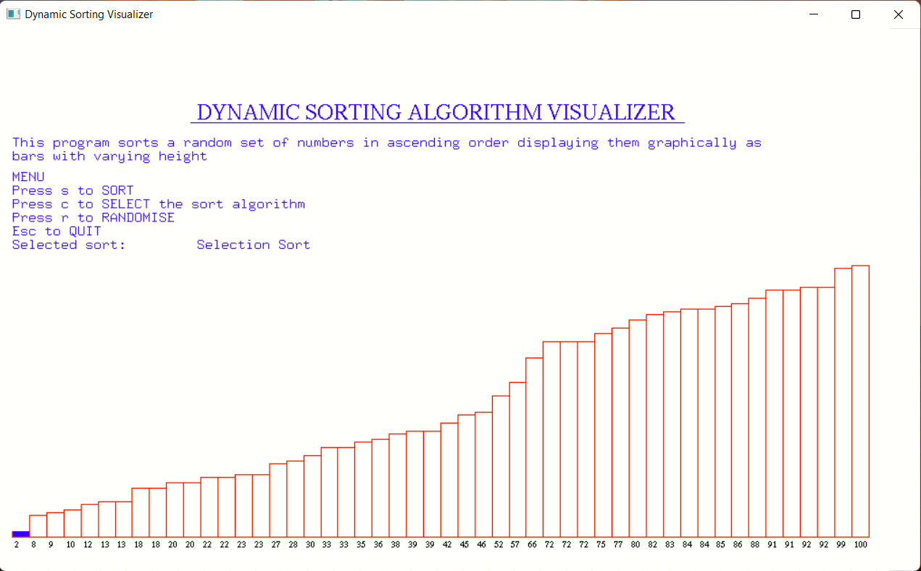

Slide 12
Applications
Educational Tool:
Helps students and learners understand sorting algorithms.
Provides a visual and interactive learning experience.
Demonstration Tool:
Useful for presentations and demonstrations in academic settings.
Analysis:
Allows developers or users to visually analyze.

Slide 13
Conclusion
The Dynamic Sorting Algorithm Visualizer is an effective tool for understanding the mechanics of various sorting algorithms. It combines the power of visualization with interactive user controls. Enhances learning and teaching experiences in computer science education.

Slide 14
Future Steps
Expansion of Algorithms:
Include additional sorting algorithms like Quick Sort, Merge Sort etc.
Enhanced Visualization:
Add more sophisticated graphical elements and animations.
User Interface Improvements:
Develop a more intuitive and user-friendly interface.
Performance Optimization:
Optimize the sorting algorithms for better performance with larger datasets.
Cross-Platform Support:
Ensure compatibility with different operating systems and devices.

Slide 15
Thank You

